Slide 1
SiFall: Practical Online Fall Detection with RF Sensing
Sijie Ji, Yaxiong Xie, Mo Li

Slide 2
Intro & Background
Acoustic-based
Wearable-based
Limited by ambient loudness(<40dB SPL) and sensing range (<4.5m).
not user-friendly: need carry and charge.
Vision-based
RF-based
Limited by light conditions (dim and occlusions), compromises user privacy.
Ubiquitous, non-invasive, privacy preserving

Slide 3
Existing RF Solutions
WiFall; RT-Fall; RFFall; FallDefi; DeFall; ……
on-going fall
Tx
Rx
detected fall
Training Signals
Learned Template
Match Template

Slide 4
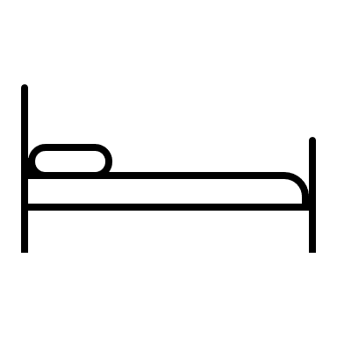
What is Fall?
diversity & ambiguity
external factor
level-change
unforeseeable
Slip
Stumble
Fall on the floor
Lying on the bed
uncontrollable
internal factor
$\vec{α}$ change
· · · · · ·
Lost consciousness
Lost balance
Fall on the floor
Sit to the chair
Fall is an accident!
how to learn a universal fall template?

Slide 5
Key Insight
Fall is hard to learn while daily activities are learnable.
diversity & ambiguity
consistent & clear
unforeseeable
repeatable
uncontrollable
controllable
· · · · · ·
· · · · · ·
Differentiate uncontrolled falls from recognizing repeatable and controlled daily activities.

Slide 6
What to learn?
Daily activities are innumerable.
Rare types of daily movements.
Personalized daily movements.
……
How to learn?

Slide 7
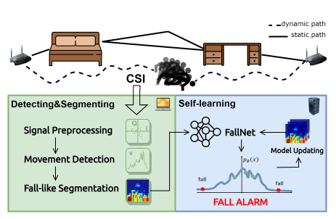
SiFall System Overview
What to learn?
How to learn?
Learn from fall-like activities.
Learn continuously and adaptively.

Slide 8
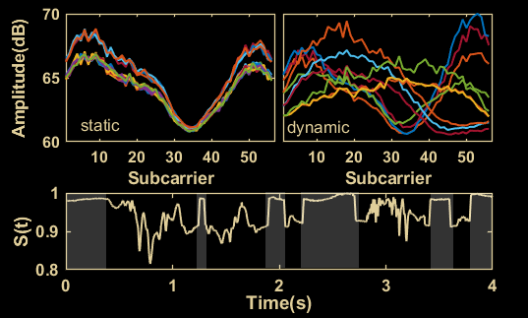
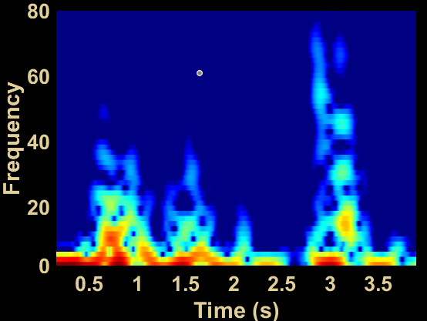
Front-end: Detecting & Segmenting
Extract Channel Dynamic From CSI
STFT
$$\hat{H}\left(f,t\right)≡H\left(f,t\right)\overline{H\left(f,t\right)}=ε_{1}^{2}(t){\left|H_{s}\left(f,t\right)+H_{d}\left(f,t\right)\right|}^{2}$$
$$S\left(t_{n}\right)=\frac{\left\langle \hat{H}\left(t_{n}\right),\hat{H}(t_{n−1})\right\rangle }{\left|\hat{H}\left(t_{n}\right)\right|\left|\hat{H}(t_{n−1})\right|}$$

Slide 9
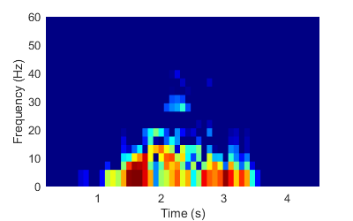
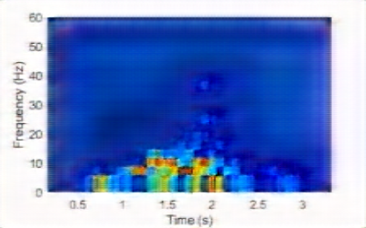
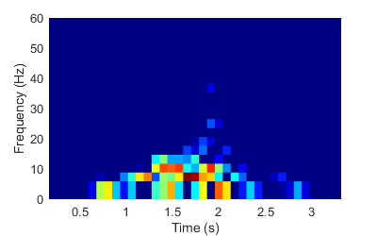
Back-end: Self-learning FallNet
$$min{\left\|x −\hat{x}\right\|}^{2}$$
Conv + IN + LeakyReLU
Pooling
Uppooling
$$F$$
fall
$$x:sit$$
Pooling Indices
$$\hat{x}:sit$$
z
$$C$$
encoder
decoder
$$T_{i}$$
error = 0.07 -> 0.21

Slide 10
Back-end: Self-learning FallNet
$$min{\left\|x −\hat{x}\right\|}^{2}$$
Conv + IN + LeakyReLU
Pooling
Uppooling
$$F$$
ɛ
$$x:sit$$
σ
iteration
Pooling Indices
$$\hat{x}:sit$$
constrain
z
µ
$$C$$
encoder
decoder
$$T_{i}$$
$$minD_{KL}\left(p_{θ}\left(z | x\right)||p(z|x∈A_{c})\right)$$
Fall-like daily activities are innumerable.
The FallNet may overfit to the dominant type of fall-like activity.

Slide 11
Implementation
COTS WiFi with Atheros-CSI-Tool, PC with one Nvidia 2080Ti GPU.
#Person | 1 | 2 | 3 | 4 | 5 | 6 | 7 | 8 | 9 | 10 | 11 | 12 | 13 | 14 | 15 | 16
Age | 34 | 25 | 21 | 25 | 28 | 27 | 26 | 25 | 29 | 27 | 25 | 29 | 26 | 22 | 52 | 56
Height(cm) | 165 | 167 | 177 | 188 | 184 | 171 | 173 | 155 | 186 | 173 | 165 | 175 | 172 | 166 | 173 | 155
Weight(kg) | 62 | 52 | 65 | 85 | 73 | 61 | 74 | 42 | 100 | 65 | 52 | 71 | 63 | 53 | 60 | 62
Gender | M | F | M | M | M | M | M | F | M | M | F | M | M | F | M | F

Slide 12
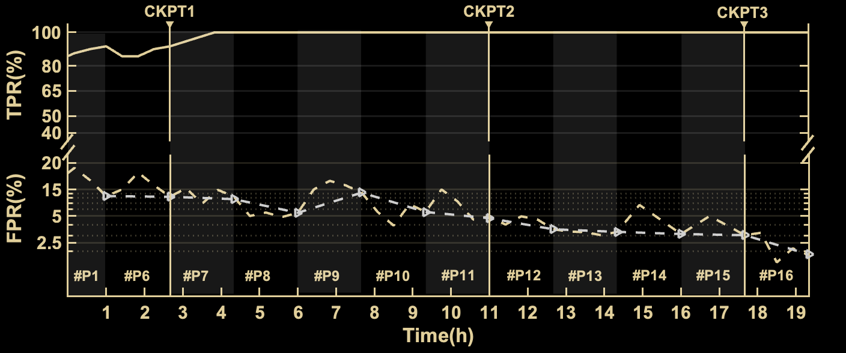
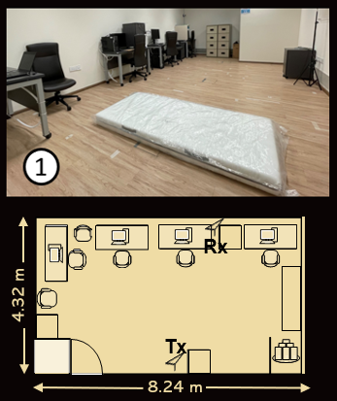
Testbed Evaluation
TPR = True Positive Rate = true falls out of SiFall reported falls
FPR = False Positive Rate = falsely reported falls out of other activities
100% TPR ~4 hours
1.8% FPR after 19.3 hours

Slide 13
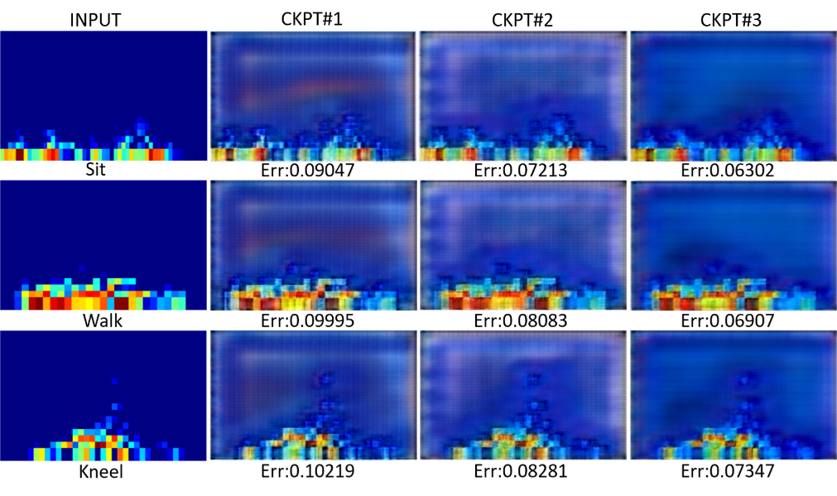
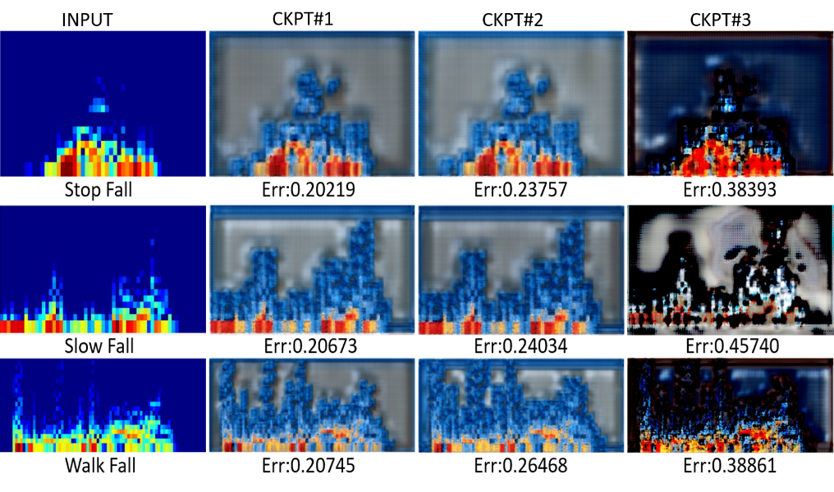
FallNet Visualization
Time
Time

Slide 14
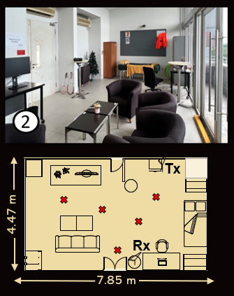
Daily Life Adoption
16 out of 17 different falls are successfully detected.
(roll from the bed fall)

Slide 15
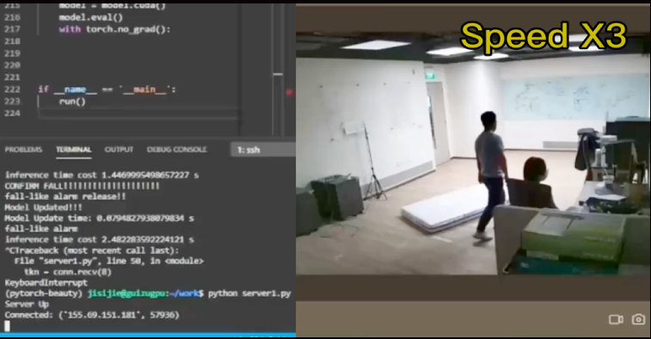
Real-time Demo

Slide 16
Thanks! Q&A？

Slide 17
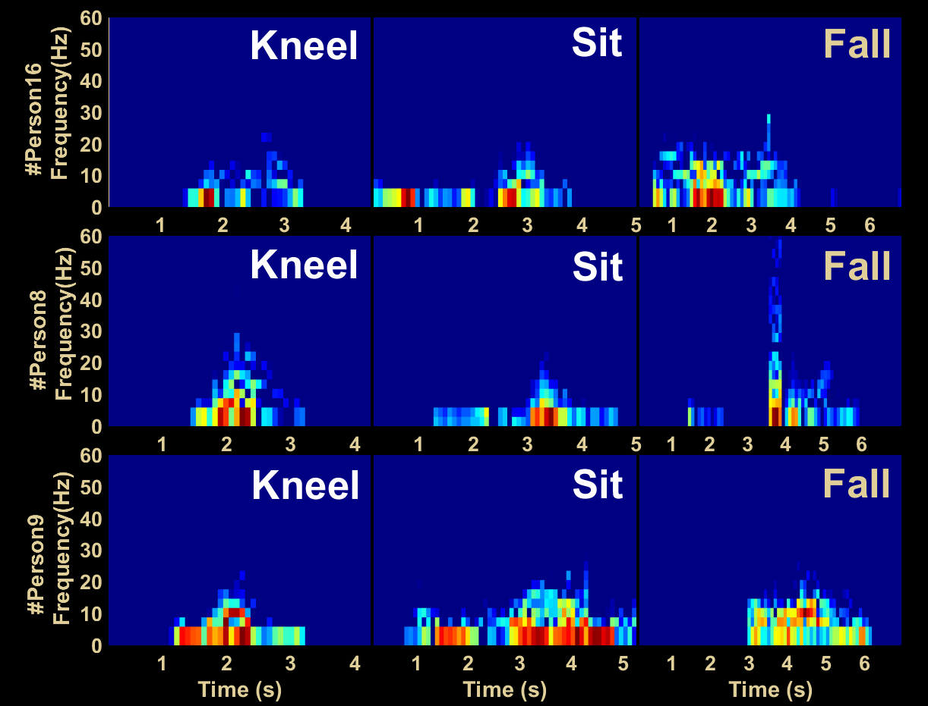
Observation

Slide 18
Model Updating
update
α
avg e
α
suspicious samples
Fall!
Error e
Real-time Seg
FallNet
Reconstruction
fall samples with timestamp
if e < α model updated and α updated
if α < e < 2α α updated and the sample be saved as reference
if 2α < e detected as a fall and the sample be saved as reference

